Slide 1
Strategy and Management Control system

Slide 2
Tasks Involved in Strategic Management & MCS
Defining business and stating a mission
Setting measurable objectives
Crafting a strategy to achieve objectives
Implementing a strategy
Evaluating performance of the strategy, reviewing new developments and taking corrective action

Slide 3
The essence of strategy of the organization
Perspective strategy or rational view
An emergent view

Slide 4
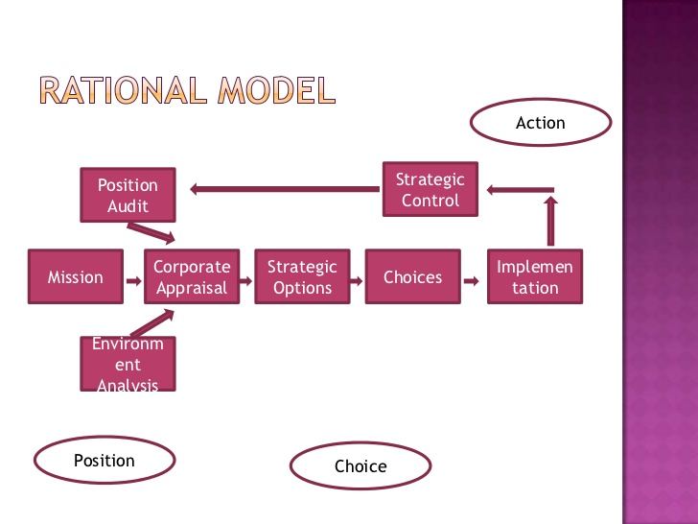
Rational perspective

Slide 5
Developing a Mission & Objectives
An organization’s Mission
  Reflects management’s purpose of operating the business
  Provides a clear view of what the organization is trying to accomplish for its customers
  Indicates intent to take a business position
An organization’s Objectives
  Convert the mission into performance targets
  Track performance over time
  Must be achievable
  Two types
    Financial – outcomes that relate to improving financial performance
    Strategic – outcomes that will result in greater competitiveness & stronger long-term market position

Slide 6
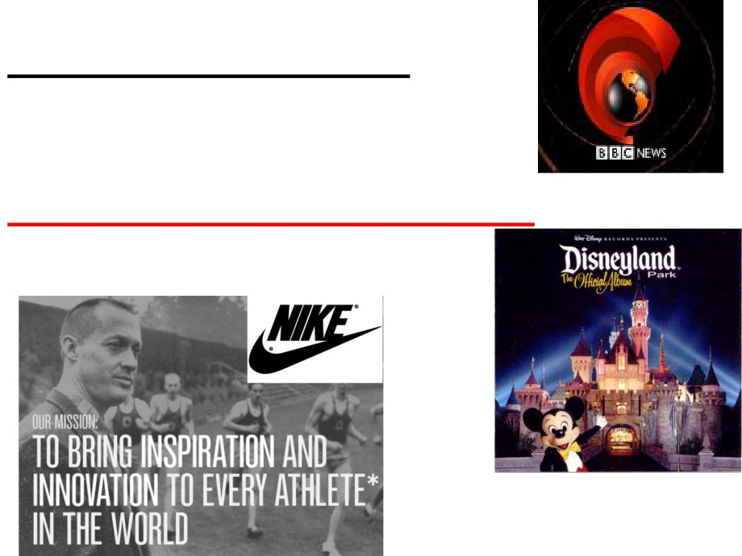
BBC’s purpose statement
“To educate, inform and entertain”
Walt Disney’s Purpose Statement
“To make people happy”

Slide 7
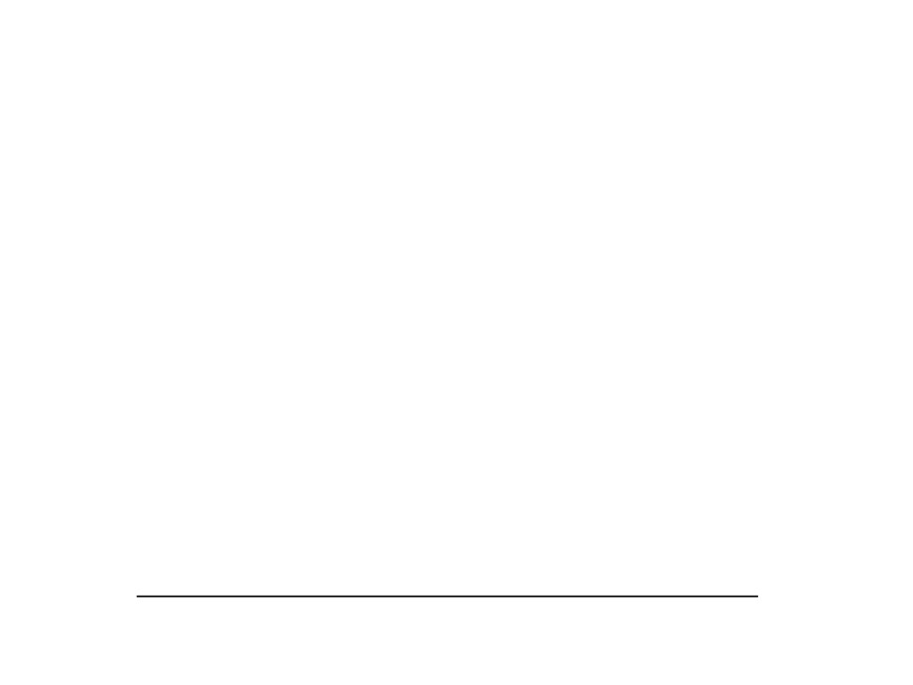
Management accounting and strategy
• Objectives
- Specific statement of what the organisation aims to
achieve, often quantified and relating to a specific
period of time (SMART)
• Strategies
-
  Strategy is the direction and scope of an organisation over the long term which achieves advantage for the organisation through its configuration of resources within a changing environment to fulfil stakeholder expectations.
G. Johnson and K. Scholes Exploring Corporate Strategy 6th edition

Slide 8

The essence of strategic management-a perspective view
• Major decisions
- What business will we operate in?
- What are our basic directions for the future
- What systems and structures should we have in place
to support our strategies?
• Corporate strategy
- Decisions about the types of businesses to operate in,
which businesses to acquire and divest, and how best
to structure and finance the organisation

Slide 9

If DSI confines itself footwear business,
can they offer tyres , tubes, schoolbags?

Slide 10
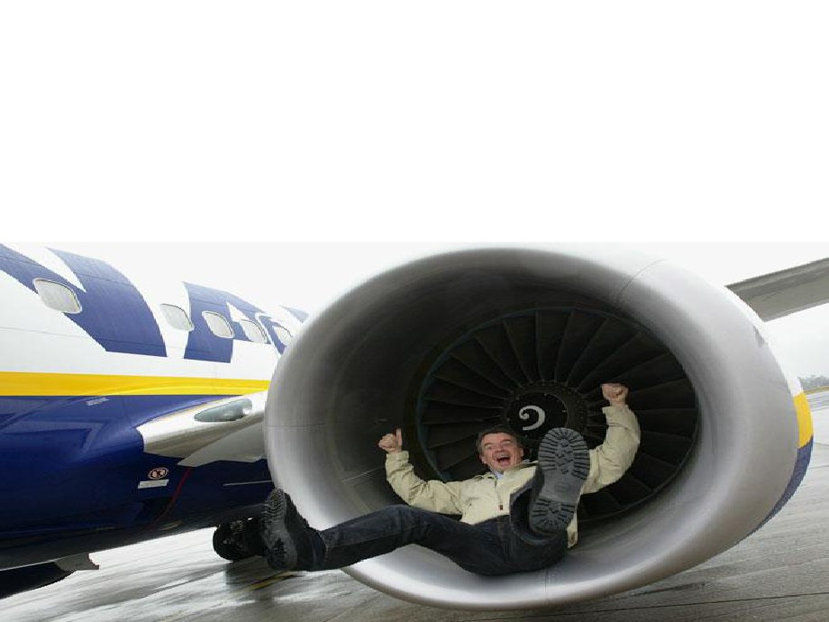
What business are you in?
If you want to travel from London to Manchester,
you can choose from the train, coach, car or
aeroplane, so what business should Ryanair be in?

Slide 11
Levels of Strategy
Corporate strategy
Business strategy
Functional strategy

Slide 12
Corporate Level Strategy
What businesses are we in? What businesses should we be in?
Four areas of focus
  Diversification management (acquisitions and divestitures)
  Synergy between units
  Investment priorities
  Business level strategy approval (but not crafting)

Slide 13
Corporate-Level Strategies
Valuable
strengths
Concentric/Related Diversification
Corporate
growth
strategies
(Economies of Scope)
Conglomerate/Unrelated
Diversification
(Risk Mgt.)
Corporate
stability
strategies
Firm
Status
Corporate
retrenchment
strategies
Critical
weaknesses
Turn around/Divestment/Liquidation
environmental
opportunities
Critical
environmental
threats
Environmental Status

Slide 14
The BCG “Portfolio” Matrix
Market Share
High
Low
Stars
Question Marks
?
?
?
High
?
Anticipated
Growth
Rate
Cash Cows
Dogs
Low

Slide 15
Portfolio decision
 | A | B | C | Total
Revenue | 1 m | 2m | 3m | 6.00
-Variable cost | 0.2 | 0.5 | 1.5m | (2.20)
Contribution | 0.8 | 1.5m | 1.5m | 3.80m
-Fixed cost | 0.9 | 0.9 | 0.9 | 2.7m
Profit | (0.1) | 0.6 | 0.6 | 1.1m
Product A in the portfolio has been making continues losses during last few financial years of the company. Advice whether the product A should be discontinued or not.

Slide 16
Business Level Strategy
How do we support the corporate strategy?
How do we compete in a specific business arena?
Three types of business level strategies:
  Low cost producer
  Differentiator
  Focus
Four areas of focus
  Generate sustainable competitive advantages
  Develop and nurture (potentially) valuable capabilities
  Respond to environmental changes
  Approval of functional level strategies

Slide 17
Functional / Operational Level Strategy
Functional: How do we support the business level strategy?
Operational: How do we support the functional level strategy?
An example.
Business L.S.: Become the low cost producer of widgets
Functional L.S. (Mfg.): Reduce manufacturing costs by 10%
Operational (Plant #1): Increase worker productivity by 15%

Slide 18
A Simple Organization Chart
(Single Product Business)
Business
Level
Strategy
Business
Research and
Development
Human
Resources
Manufacturing
Marketing
Finance
Functional
Level
Strategy

Slide 19
A Simple Organization Chart
(Dominant or Related Product Business)
Corporate
Level
Multi
business
Corporation
Business
Level
Business 1
(Related)
Business 2
(Related)
Business 3
(Related)
Functional
Level
Research and
Development
Human
Resources
Manufacturing
Marketing
Finance

Slide 20
An example of an Unrelated Product Business
(Note: By itself, an SBU can be considered a related product business)
SBU: a single business or collection of related businesses that is independent and formulates its own strategy
A
(Multi-business) Corporation
Ex.: G.E. (General
Electric Corp.)
Strategic Business Unit 1
S.B.U.
2
Company 1
Co. 2
Co. 3
Division 1
Div. 2
Div. 3

Slide 21
An emergent view
Emphasize the uncertainty of the future and suggest that setting out identify purpose and a single strategy and then develop a complete strategic plan may be fruitless task

Slide 22
What is emergent perspective to strategy
A set of certain consistent actions that form an unintended pattern that was not initially anticipated or intended in the initial planning phase. For example, although unintended, adopting an emergent strategy might help a business adapt more flexibly to the practicalities of changing market conditions.
Strategy
More planned approached/ Intended strategy
Emerged outside the formal plan /Unintended pattern recognizing the changing conditions

Slide 23
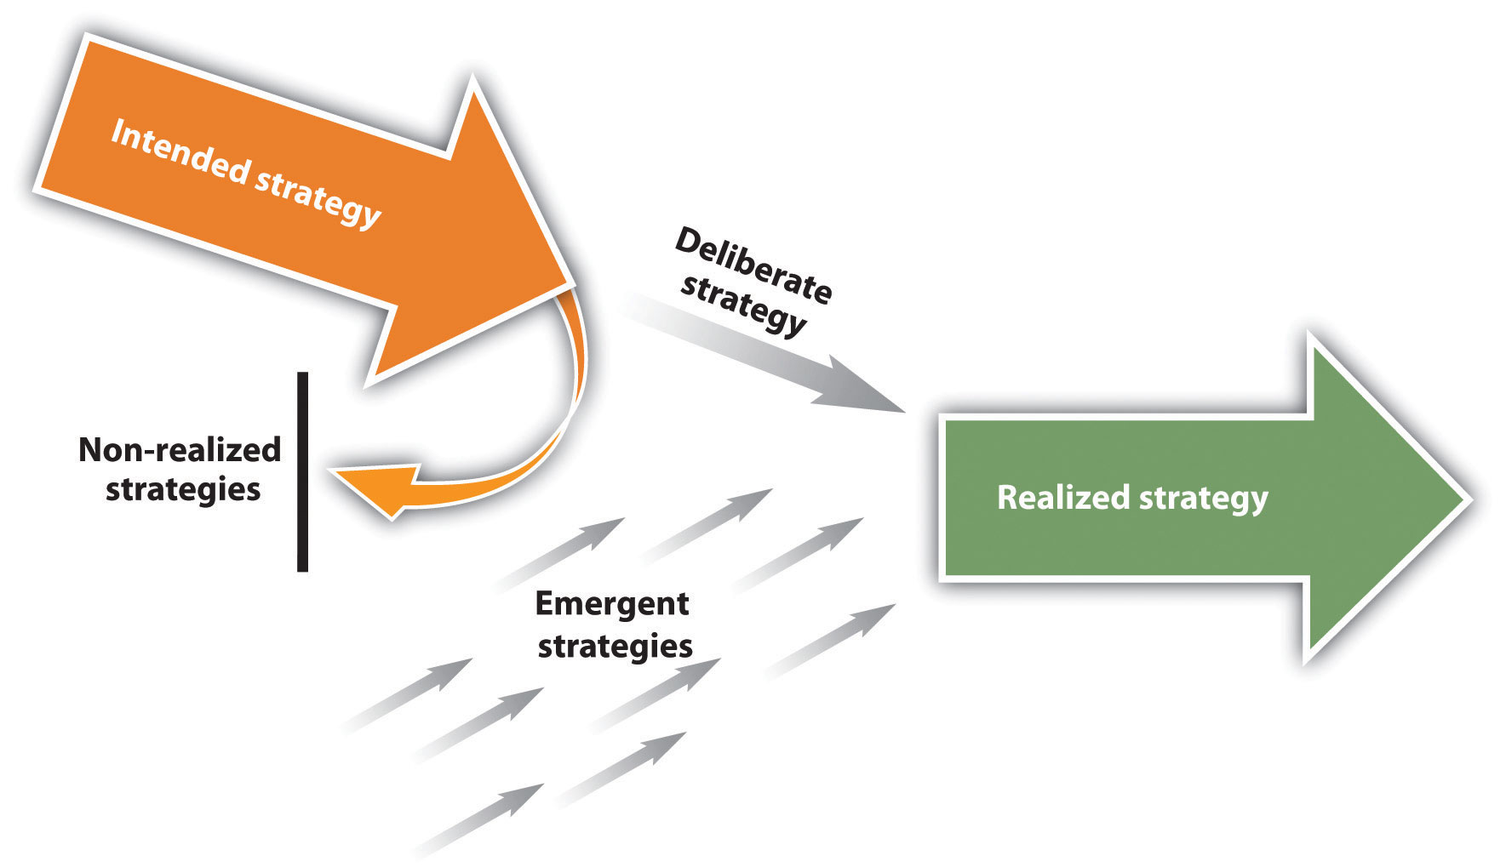
Henry Mintzberg's emergent strategy

Slide 24
Strategic drift
Strategic happens when organization strategy is no longer relevant to the external environment facing it
Environment forces
?????
Intended strategy through Deliberate planning process
Strategic drift

Slide 25
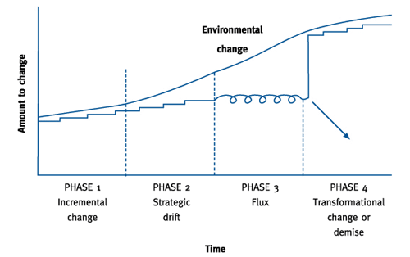
Rate of responding to the environmental change

Slide 26



What if you don’t redefine your business purpose –Strategic drift

Slide 27
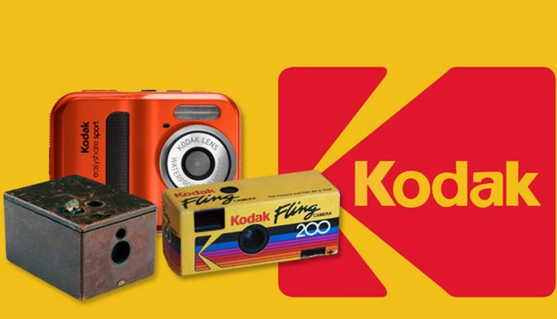
Slow response to the market led to strategic drift

Slide 28
How can companies survive a strategic drift
Organizational leadership and adaptable culture
Continues assessment of trends, emergence of direct and indirect competitors, technological changes and adjustment in to the current plan. https://www.youtube.com/watch?v=dqwAZKrc6vw

Slide 29
Financial Implication of strategic management decisions

Slide 30
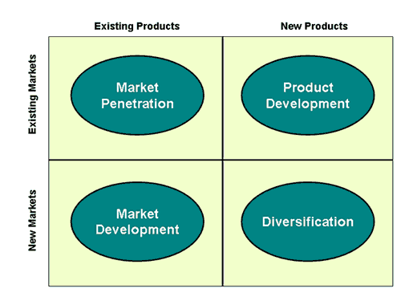
Corporate Strategic Decision
Growth decision
Source: Ansoff Matrix (Igo Ansoff)

Slide 31
Governance issue
Ownership
Control
Vs

Slide 32
Financial Feasibility
Evaluating the financial feasibility of such a decision will ensure that share holders money are invested in a profitable investment opportunity.

Slide 33

How to evaluate the corporate strategic decisions
Discounted Cash Flow Methods
  Net Present Value (NPV)
  Internal Rate of Return (IRR)
Non-Discounted Cash Flow Methods
  Payback Method
  Accounting Rate of Return

Slide 34
Projections
This is the most crucial part of the long term investment decision evaluation. Accurately forecast the cost and the revenue for given period will have significant impact to the decision.

Slide 35
Assume that your company management is planning to put up a 200 rooms hotel in Trincomalee which will require initial capital outlay USD 500 million. Project the possible cash flows for next five years and what factors should be considered in the determination of the cash flows.

Slide 36
Discounted Cash Flow Methods
NPV - the sum of discounted future cash flows less the initial cost
IRR - the discount rate where NPV = 0

Slide 37
Net Present Value (NPV)
NPV =
C1
(1 + r)¹
+
C2
(1 + r)²
+
C3
(1 + r)³
- C0
Initial Cost
Discounted cash flows
C1, C2, C3 = the project cash flows,
r = discount rate (related to risk of the project)
C0 = initial cost

Slide 38
Investment Decisions
The board of directors of Magoo plc. is considering investing in a new machine that is expected to have a three year life and will cost £80,000. The machine is used to produce a good that is expected to have the following cash flows over the three years of the machine’s life - Year 1 = £30,000; Year 2 = £50,000; Year 3 = £40,000. Cost of capital is 8%
Should it purchase the machine?

Slide 39
Fundamental Rule of Finance/Financial Economics
A capital investment decision is only worthwhile if it adds value. Thus, invest only in projects with a positive net present value

Slide 40
Student Activity
You are the financial manager advising the board of Alpha plc. on potential investment projects and have the choice between two projects of the same risk classification whose cash flows are given below:
Year | Cash flow of Project X | Cash flow of Project Y
0 | -120,000 | -80,000
1 | 20,000 | 40,000
2 | 60,000 | 40,000
3 | 100,000 | 30,000
Given that the firm expects to obtain a 10% return on projects of this level of risk, provide a recommendation to the board on the viability of the two projects

Slide 41
INTERNAL RATE OF RETURN (IRR)
Also based on Discounted Cash Flow, but calculates the discount rate that will give a Net Present Value of zero.
This also represents the return that the project is giving on the original investment, expressed in DCF terms.
The simplest way is to use trial and error - trying different rates until the correct rate is found. But this is laborious.
There is a formula, using linear interpolation.
Projects should be accepted if their IRR is greater than the cost of capital or hurdle rate.

Slide 42
IRR – Interpolation method
Where: L is the lowest discount rate
H is the higher discount rate
N_{L} is the NPV of the lower rate
N_{H} is the NPV of the higher rate

Slide 43
NPV and IRR
Gullane plc. are considering investing in a new machine that will cost £1 million. They estimate the machine will lead to an increase cash flow for the next three years of £500,000 in year 1, £600,000 in year 2, and £400,000 in year 3.
Given that Gullane plc. determine that the risk-adjusted cost of capital is 10%, calculate the Net Present Value of the machine and recommend whether to ahead with the investment or not
Calculate the Internal Rate of Return of the machine

Slide 44
Internal Rate of Return
Decision Rules
If k > r reject. If the opportunity cost of capital (k) is greater than the internal rate of return (r) on a project then the investor is better served by not going ahead with the project and using the money to the best alternative use
If k < r accept. Here, the project under consideration produces the same or higher yield than investment elsewhere for a similar risk level

Slide 45
Payback
Consider Cash flows and NOT Profits
Evaluation based on period of recovery of the initial investment
ie. Number of years it takes to cover the cost of investment
Firms should look for early payback of capital invested
Decision criteria
Compare target payback with actual payback
If actual payback period < target payback - Accept project
If actual payback period > target payback - Reject project

Slide 46
Discount factor
Cost of capital of firm
Minimum rate of return, the firm must earn on its investments
Hence also the Required rate of return
Also considered as Opportunity cost
The required rate of return must cover, the cost of all long term sources of funds
Computed as the Weighted average cost of capital

Slide 47
Cost of capital (COC)
Cost of capital is the company cost of long term source of finance which is generally used to capitalized the asset.
There are tow major sources of long term funds.
Equity and Debt capital

Slide 48
Cost of Equity
The most commonly accepted method for calculating cost of equity comes from the Nobel Prize-winning capital asset pricing model (CAPM): The cost of equity is expressed formulaically below:
Re = r_{f} + (r_{m} – r_{f}) * β
Where:
Re = the required rate of return on equity
r_{f} = the risk free rate
r_{m} – r_{f} = the market risk premium
β = beta coefficient = unsystematic risk

Slide 49
Cost of debt
Cost of debt is the interest paid to lenders
Debt is tax shield and should be adjusted to derive the cost of debt net of tax
Kd= I (1-Tax rate)

Slide 50
Weighted Average Cost Of Capital (WACC
Weighted average cost of capital (WACC) is a calculation of a firm's cost of capital in which each category of capital is proportionately weighted. All capital sources - common stock, preferred stock, bonds and any other long-term debt - are included in a WACC calculation.
All else equal, the WACC of a firm increases as the beta and rate of return on equity increases, as an increase in WACC notes a decrease in valuation and a higher risk.

Slide 51
WACC
Where,
WACC= KeVe + KdVd
Ve+Vd
Ke=Cost of equity
Ve=Value of equity
Vd=Value debt
Kd=Cost of debt

Slide 52
Student Activity
Ashanti plc., are considering an investment of USD 1.9 m to enter in to the north east region of Sri Lanka. The capital investment is expected to have equal lives of 3 years and the cash flows for each year is given below: Any capital expenditure project is evaluated at corporate WACC as a hurdle rate.
First year of the project is exempted from tax and 10% is applied after that.
 | Year 0 | Year 01 | Year 02 | Year 03
Investment | 1,900,000
Revenue |  | 1,000,000 | 1,400,000 | 2,000,000
Operational cost |  | 300,000 | 300,000 | 300,000
Ashanthi plc has 10 million equity and 5 million debt. It has 10% pa interest payment commitment in its debt and shareholders require 14 % return on their investment. The corporation tax rate is 28%.
You are required to evaluate the financial feasibility of the new expansion using NPV, IRR and the pay back period.

Slide 53
1st Assessment –Group work
Weightage : 10% to the final assessment
Case study: Why did Kodak collapse
Kodak formerly one of the world's leading photographic companies. Bankruptcy protection in 2012. Why? What went wrong with its business strategy?

Slide 54
Strategic analysis
The basic frame work: Strategy as a link between the firm and its environment
The firm
Goals and values
Resources and capabilities
Structure and system
Micro and Macro environmental changes
Strategy
Strategic fit
Fundamental of strategy as the link between the firm and its external environment is the notion of strategic fit. For a strategy to be successful it must be consistent with the firm external environment and with its internal firm goals, resources and capabilities and the structure

Slide 55
Strategic analysis
Strategic analysis
Analysis of firm
Goals, values and performance , analyzing capabilities and resources
Analysis of macro , industry and competitive environment

Slide 56
Creating value
Successful strategy is creating value
Continuously creating customer value
Firm value
Shareholder value

Slide 57
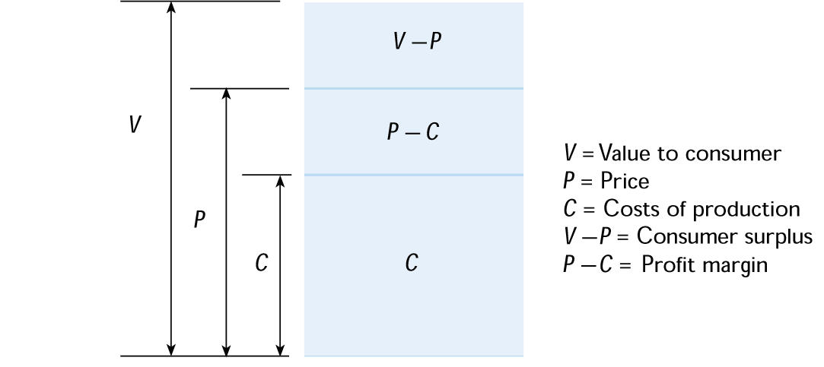
Value Creation

Slide 58
The Basic
Value Chain
Margin
Margin
Service
Technological Development
Marketing & Sales
Human Resource Mgmt.
Support Activities
Firm Infrastructure
Outbound Logistics
Procurement
Operations
Inbound Logistics
Primary Activities

Slide 59
Value Chains are part of a Total Value System
Supplier Value Chain
Firm Value Chain
Channel Value Chain
Buyer Value Chain
Notes:
69

Slide 60
In Whose interest ? Share holders Vs Stake holders
Shareholder capitalism
Stakeholder approach
Vs

Slide 61
Diagnosing the firm current strategy
Strategy formulation
Assess the current situation
Identify the current strategy of the firm and assess how well that strategy is doing in terms of financial performance
Identify the inadequacies of firm value drivers and reason for deviations-Internally driven or external driven
Strategic or operational level actions

Slide 62
Performance diagnosis
Diagnosis is primarily starts from accounting based financial performance indicator of Return on capital employed or ROCE. Any disaggregation of ROCE in to fundamental of value drivers. Du point analysis reflects the value drivers and its impact on ROCE.
ROCE
Return on sales
COGS/Sales
Depreciation/Sales
Sales on capital employed
Fixed asset turn over
SGA/Sales
Inventory turn over
Debtors turn over

Slide 63
Analyzing internal environment (internal capabilities, resources)
SWOT analysis is the conventional management technique which is used to assess the company current position.
Evaluate the strength, weakness , opportunities and threat

Slide 64
SWOT Analysis
SWOT analysis is a process that identifies the strengths, weaknesses, opportunities and threats of an organization. Specifically, SWOT is a basic, analytical framework that assesses what an organization can and cannot do, as well as its potential opportunities and threats.
A SWOT analysis takes information from an environmental analysis and separates it into internal strengths and weaknesses, as well as its external opportunities and threats.

Slide 65
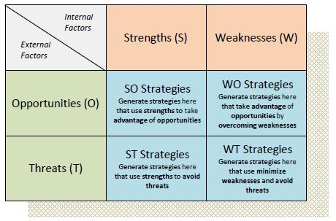
TOWS Analysis
Extension of the SWOT analysis is TOWS and can be presented as TOWS matrix analysis to match the internal factors with external factors of the business to define the strategic direction.

Slide 66
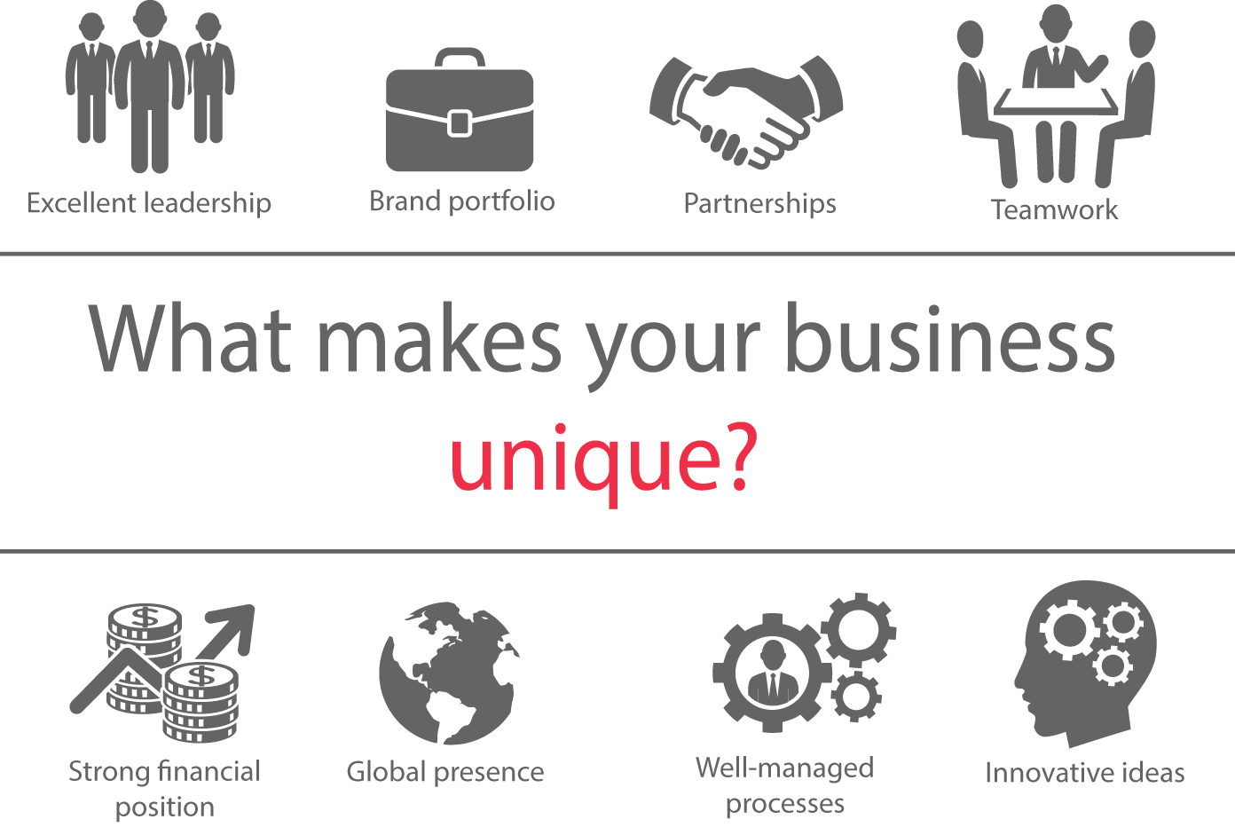
Resource-based strategy
The resource-based view (RBV) of strategy asserts that the competitive advantage and superior performance of an organisation is explained by the distinctiveness of its capabilities.

Slide 67
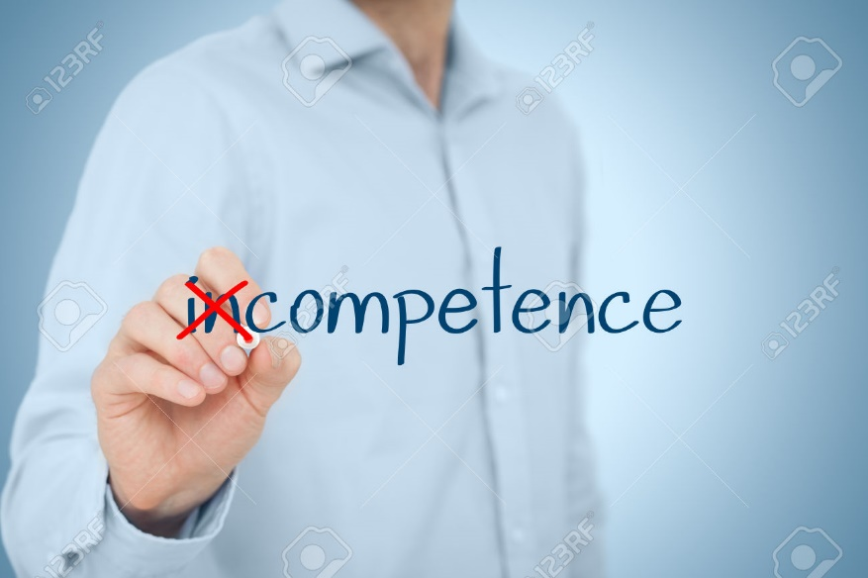
Resources and competences
Resources are the assets that organisations have or can call upon (e.g. from partners or suppliers),that is, ‘what we have’ .
Competences are the ways those assets are used or deployed effectively, that is, what we do well’.

Slide 68
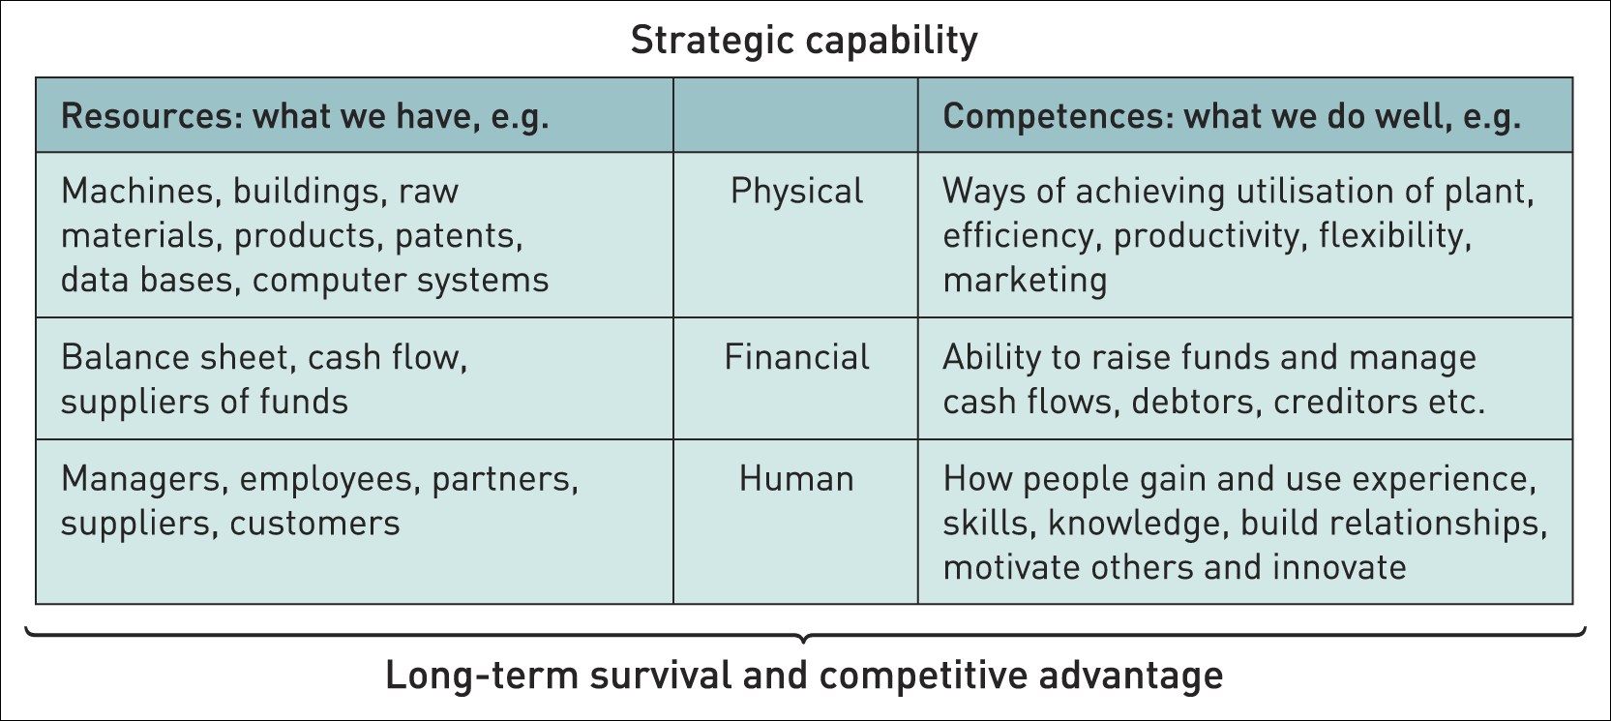
Components of strategic capabilities

Slide 69

Threshold and distinctive capabilities
Threshold capabilities are those needed for an organisation to meet the necessary requirements to compete in a given market and achieve parity with competitors in that market – ‘qualifiers’.
Distinctive capabilities are those that critically underpin competitive advantage and that others cannot imitate or obtain – ‘winners’.

Slide 70

Core competences
Core competences are the linked set of skills, activities and resources that, together:
deliver customer value
differentiate a business from its competitors
potentially, can be extended and developed as markets change or new opportunities arise.

Slide 71
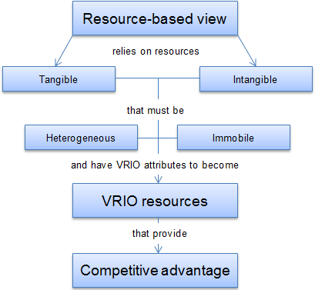
VRIN framework
V = Value
R = Rare
I = Costly to Imitate
N= Non substitutability

Slide 72
Analyzing the outside environment
PESTEL analysis
Scenario planning
Industry analysis/5 forces analysis
Competitor analysis

Slide 73
The PESTEL framework
The PESTEL framework categorises environmental influences into six main types:
political, economic,
social, technological,
environmental legal
Thus PESTEL provides a comprehensive list of influences on the possible success or failure of particular strategies.

Slide 74
The PESTEL framework (2)
Political Factors: For example, Government policies, taxation changes, foreign trade regulations, political risk in foreign markets, changes in trade blocks (EU).
Economic Factors: For example, business cycles, interest rates, personal disposable income, exchange rates, unemployment rates, GDP trends.
Socio-cultural Factors: For example, population changes, income distribution, lifestyle changes, consumerism, changes in culture and fashion.

Slide 75
The PESTEL framework (3)
Technological Factors: For example, new discoveries and technology developments, ICT innovations, rates of obsolescence, increased spending on R&D.
Environmental (‘Green’) Factors: For example, environmental protection regulations, energy consumption, global warming, waste disposal and re-cycling.
Legal Factors: For example, competition laws, health and safety laws, employment laws, licensing laws, IPR laws.

Slide 76
Using the PESTEL framework
Apply selectively –identify specific factors which impact on the industry, market and organisation in question.
Identify factors which are important currently but also consider which will become more important in the next few years.
Use data to support the points and analyse trends using up to date information
Identify opportunities and threats – the main point of the exercise!

Slide 77
Scenarios
Scenarios are detailed and plausible views of how the environment of an organisation might develop in the future based on key drivers of change about which there is a high level of uncertainty.
Build on PESTEL analysis .
Do not offer a single forecast of how the environment will change.
An organisation should develop a few alternative scenarios (2–4) to analyse future strategic options.

Slide 78
Carrying out scenario analysis
Identify the most relevant scope of the study – the relevant product/market and time span.
Identify key drivers of change – PESTEL factors that have the most impact in the future but have uncertain outcomes. Develop scenario ‘stories’ - That is, coherent and plausible descriptions of the environment that result from opposing outcomes
Identify the impact of each scenario on the organisation and evaluate future strategies in the light of the anticipated scenarios.

Slide 79
Analysing Competitive Industry Structure
An industry is a group of firms that market products which are close substitutes for each other (e.g. the car industry, the travel industry).
Some industries are more profitable than others. Why? The answer lies in understanding the dynamics of competitive structure in an industry.
Notes:
Introduction and assumptions

Slide 80
Porter’s five forces framework
Porter’s five forces framework helps identify the attractiveness of an industry in terms of five competitive forces:
the threat of entry,
the threat of substitutes,
the bargaining power of buyers,
the bargaining power of suppliers and
the extent of rivalry between competitors.
The five forces constitute an industry’s ‘structure’.

Slide 81
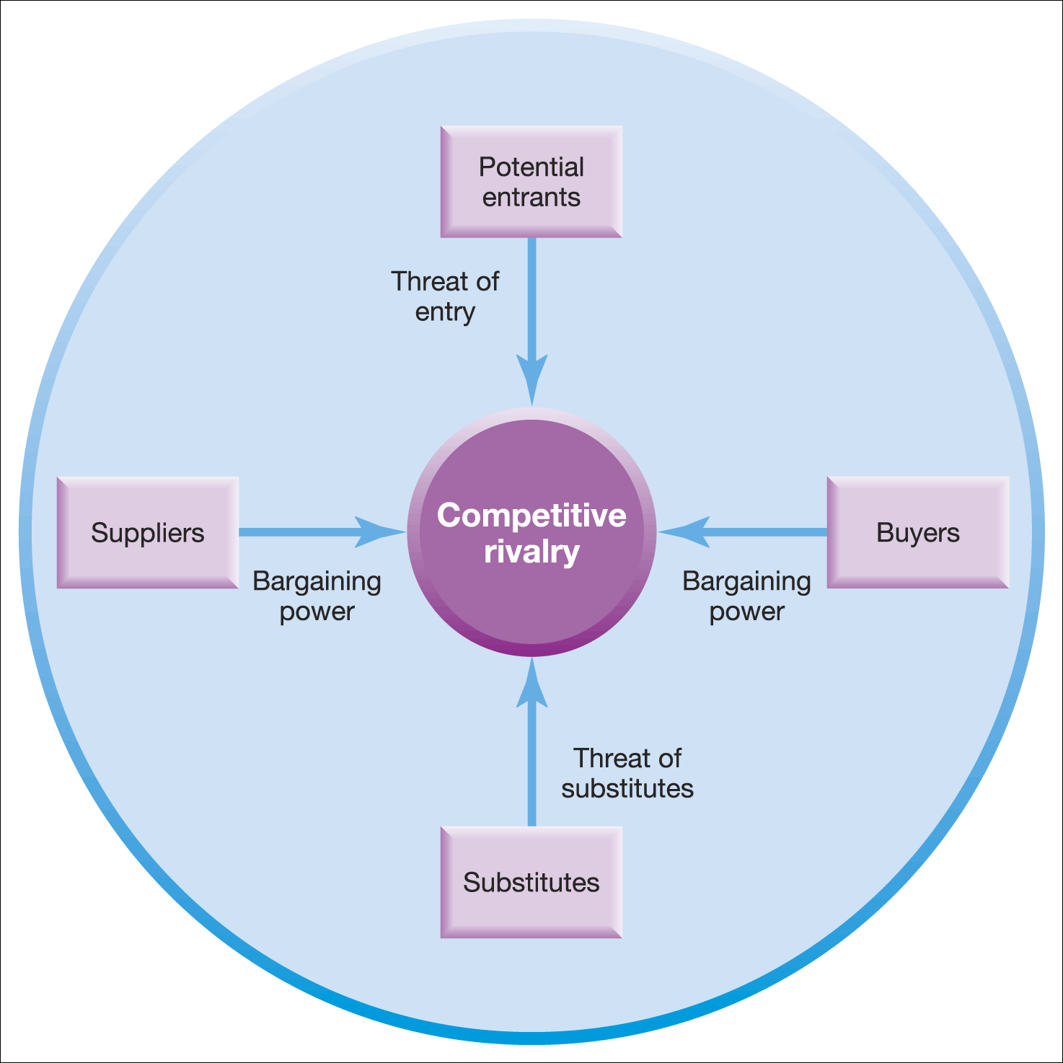
The five forces framework
The five forces framework
Source: Adapted with the permission of The Free Press, a Division of Simon & Schuster Adult Publishing Group, from Competitive Strategy: Techniques for Analyzing Industries and Competitors by Michael E. Porter. Copyright © 1980, 1998 by The Free Press. All rights reserved

Slide 82
Threat of New Entrants
New entrants to an industry can raise the level of competition, thereby reducing its attractiveness.
The threat of new entrants largely depends on the barriers to entry.
High entry barriers exist in some industries (e.g. shipbuilding) whereas other industries are very easy to enter (e.g. estate agency).
Notes:
Identify the entrance of Interbrew
Coors now owns Carling

Slide 83
Key barriers to entry include
Economies of scale
Capital / investment requirements
Brand loyalty and customer switching costs
Access to industry distribution channels
Notes:
-EoS recent industry restructuring suggests significant at the volume end. Withdrawl of Bass &Whitbread may suggest MES has increased.Now 4 Big players
-Significant see cost of acquisitions and estates of pub-owning companies
-Probably not significant beyond brand loyalty
- decline of tied houses almost replaced by pub-owning companies, Supermarkets now dominate off-trade, access for micro breweries improved
- fewer large players but oversupply remains
pub -owning companies price war

Slide 84
Threat of Substitutes
The presence of substitute products can lower industry attractiveness and profitability because they limit price levels. The threat of substitute products depends on:
Notes:
-other consumers of the leisure spend, entertainment, other ‘rush’ products, soft drugs, a healthy lifestyle
Depends on your addiction

Slide 85
Bargaining Power of Suppliers (Suppliers are the businesses that supply materials & other products into the industry)
The cost of items bought from suppliers (e.g. raw materials, components) can have a significant impact on a company's profitability. If suppliers have high bargaining power over a company, then in theory the company's industry is less attractive.
Notes:
Essentially water and agricultural products

Slide 86
The bargaining power of suppliers will be high when:
- There are many buyers and few dominant suppliers
- The offer unique or scarce resources with high switching costs
- Suppliers threaten to integrate forward into the industry
Notes:
Water and to a large extent grain tend to be undifferentiated
Brewing does consume great quantities but agric fragmented and water more competitive than in the past

Slide 87
Bargaining Power of Buyers (Buyers are the people / organisations who create demand in an industry)
The bargaining power of buyers is greater when
- There are few dominant buyers and many sellers in the industry
- Products are standardised
Notes:
Equally balanced at the moment
- have tried hard through advertising and branding to prevent this
- no real sign of this yet even with the larger pub-owners Competition rules?
Competition rules

Slide 88
Intensity of Rivalry
The intensity of rivalry between competitors in an industry will depend on:
- The structure of competition - for example, rivalry is more intense where there are many small or equally sized competitors; rivalry is less when an industry has a clear market leader
- The maturity of the industry, a lack of growth will lead to a ‘shakeout’
Notes:
There has been considerable upheaval the dust is still settling, more concentrated
lack of growth likely to increase rivalry in the future

Slide 89
Intensity of Rivalry
Degree of differentiation through brand loyalty; industries where competitors can differentiate their products have less rivalry
- Switching costs - rivalry is reduced where buyers have high switching costs - i.e. there is a significant cost associated with the decision to buy a product from an alternative supplier
Notes:
Examples of substitutability
potentially low switching cost - supermarkets, pub-owners may be more dependent

Slide 90
Intensity of Rivalry
The height of entry barriers
Exit barriers - when barriers to leaving an industry are high (e.g. the cost of closing down factories) - then competitors tend to exhibit greater rivalry.
Notes:
These are significant at the moment apart from the threat of international competition
Significant in an industry with little growth, more powerful buyers and competition restriction - witness sale of Bass to interbrew

Slide 91
Implications of five forces analysis
Identifies the attractiveness of industries – which industries/markets to enter or leave.
Identifies strategies to influence the impact of the forces, for example, building barriers to entry by becoming more vertically integrated.
The forces may have a different impact on different organisations e.g. large firms can deal with barriers to entry more easily than small firms.

Slide 92
Competitor analysis
Identifying the competitors
Assessing the competitors
Selecting the competitors to attack or avoid

Slide 93
Strategic options evaluation
& Choice

Slide 94
Strategy-Formulation Analytical Framework
Internal Factor Evaluation
Matrix (IFE)
Stage 1:
The Input Stage
Competitive Profiling
External Factor Evaluation
Matrix (EFE)
Note: EFE and CP form external and IFE from internal (assessment)

Slide 95
Strategic alternatives
Market development
Market penetration
Product development
Forward integration
Backward integration
Horizontal integration
Concentric diversification
Retrenchment
Concentric diversification
Horizontal diversification
Conglomerate diversification
Liquidation
Joint ventures
Mergers & Acquisitions

Slide 96
Market option matrix and Expansion method matrix
Corporate strategic options
Market penetration | Product development
Market development | Diversification –Related Unrelated
Company
Inside
Outside
Internal development | Mergers & Acquisition Joint venture Alliances Franchises
Exporting Overseas office Overseas manufacture Multinational operation Global operation | Mergers & Acquisition Joint venture Alliances Franchises Licensing
Home country
Geographical location
International

Slide 97
Matching Key Factors to Formulate Alternative Strategies
Key Internal Factor
Key External Factor
Resultant Strategy
Excess working capacity (strength)
+
20% annual growth in the cell phone industry (opportunity)
=
Acquire Cellfone, Inc.
Insufficient capacity (weakness)
+
Exit of two major foreign competitors from the industry (opportunity)
=
Pursue horizontal integration by buying competitor's facilities
Strong R&D (strength)
+
Increasing middle class and people become or health conscious
=
Develop new products or remodified the existing carbonated drink as lifestyle products
Market and brand leadership
+
Existing market become or matured
=
Getting in to international market

Slide 98
Strategic alternative choice
Johnson & Scholes SFA matrix
Suitability
Feasibility
Acceptability

Slide 99
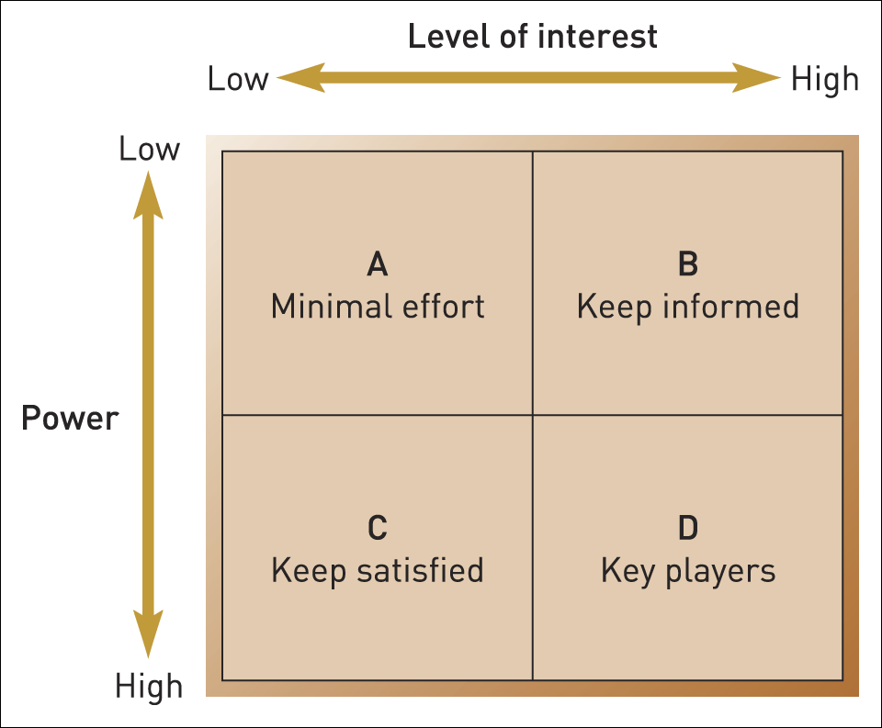
Stakeholder mapping: the power/interest matrix
Source: Adapted from A. Mendelow, Proceedings of the Second International Conference on Information Systems, Cambridge, MA, 1986

Slide 100
Strategy implementation and Management control system

Slide 101
Strategy Implementation

Slide 102
Keys to Strategy Implementation
Resources and competencies
Functional area sub-strategies
Specific decisions and actions

Slide 103
Resources and Competencies:
Human Resources
People possess competencies and carry out details of strategic plans
Personnel costs are high proportion of operating budget
Ensure enough people in the right places with the right competencies
Balance operational and strategic duties
Think of strategic human resource management

Slide 104
Resources and Competencies:
Organizational Structure
Formal framework of departments, units, and groups into which people and the activities they perform are organized
Some structures are better suited to certain strategies than other structures
A carefully chosen structure can give an organization a sustainable competitive advantage

Slide 105
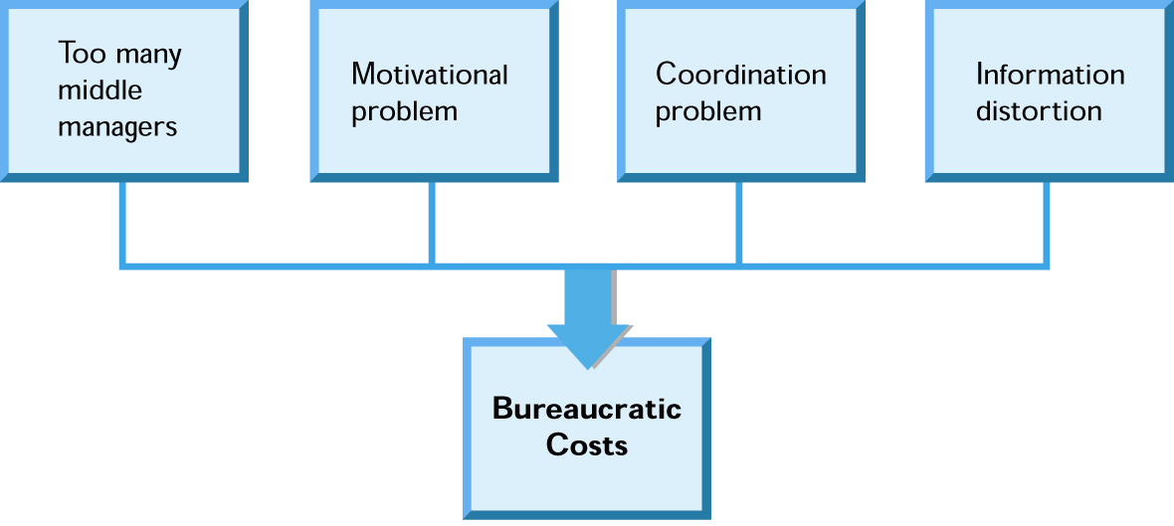
Problems with Tall Structures
Principle of minimum chain of command
  Maintaining a hierarchy with the least number of levels of authority needed to achieve a strategy.
Sources of bureaucratic costs:

Slide 106
Centralization or Decentralization
Authority patterns in organizations:
  Centralized
    Decision making retained in the
    hands of upper-level managers.
  Decentralized
    Decisions delegated to lower
    levels in the organization.

Slide 107
Structure Follows Strategy
  Changes in corporate strategy lead to changes in organizational structure

Slide 108
Stages of corporate development
Simple Structure
Functional Structure
Divisional Structure
Beyond SBU’s

Slide 109
Effective implementation requires
  Leadership
  Leading people to use their abilities and skills most effectively and efficiently to achieve organizational objectives

Slide 110
Leadership
Leadership is the process of transforming organizations from what they are to what the leader would have them become
Leadership should be
  Proactive
  Goal-oriented
  Focused on the creation and implementation of a creative vision

Slide 111
Managing corporate culture
  Corporate culture
    Affects firm’s ability to shift its strategic direction
    Strong tendency to resist change
    Corporate culture should support the strategy

Slide 112
Managing Strategic Change

Slide 113
Change
Changes takes place continuously within the organization to manage the operations. Japanizes believes small changes within the organization bring much more bigger results in the future (Kaizan).
The pace of change can be represented by two extremes.
Slow organizational change
Fast organizational change

Slide 114
What is strategic change
Strategic change is proactive management of change in organization to achieve clearly identified objective.
Proactive means that company takes initiatives to manage new strategies to overcome a strategic issue or strategic opportunity( Consumer habit changes) and managing its impact on organizational employees.

Slide 115
Pressure points of strategic change
Strategic change is primarily with people and tasks they perform in the organization.
Understanding the pressure points for influencing such a change is important if the change is to be effective.
Its undertaken through formal and informal structure of the organization

Slide 116
Tichy”s FOUR main causes of strategic change
Environment
Business relationships
Technology
People

Slide 117
Managing strategic change
Perspective approach to managing strategic change
Emergent approach to managing strategic change

Slide 118
Managing challenges of perspective change
Kert Lewin (1950) three step model
Unfreezing current attitude
Moving to a new level
Refreezing attitude at the new level

Slide 119

Management Control System
(MCS)

Slide 120
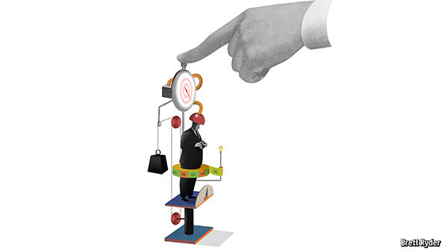
“What we manage in the business should be measured”

Slide 121
Management Control System
A management control system is a logical integration of management accounting tools to gather and report data and to evaluate performance
Purposes of a management control system
clearly communicate the organization’s goals
ensure that every manager and employee understands the specific actions required of him/her to achieve organizational goals
communicate the results of actions across the organization
ensure that the management control system adjusts to changes in the environment

Slide 122
Management Control System Steps
1. Begin by specifying the organization's goals, subgoals and objectives
  Goals are what the organization hopes to achieve in the long run
  Subgoals or key success factors are more specific and provide more focus to guide daily actions
  Objectives are specific benchmarks which management would like to see achieved
  Important to keep all three in balance to avoid concentrating solely on short-run achievements at the expense of long run goals
2. Establish responsibility centers
3. Develop performance measures
4. Measure and report on financial performance
5. Measure and report on non-financial performance

Slide 123
The Management Control System
Set Goals,
Measures,
Targets
Plan
and
Execute
Feedback
and
Learning
Evaluate,
Reward
Monitor,
Report

Slide 124
Key Performance Indicator (KPI) and Performance Measure Development
Organization goal/ Mother KPI
Departmental objective/KPI
A set of quantifiable measures that a company or industry uses to gauge or compare performance in terms of meeting their strategic and operational goals.
if a software company's goal is to have the fastest growth in its industry, its main performance indicator may be the measure of revenue growth year-on-year.
Team objective/KPI
Individual objective/KPI

Slide 125
Periodical performance measurement system
Feed forward performance measurement
Feed back performance measurement

Slide 126
Developing a performance matrix
Developing performance metrics usually follows a process of:
Establishing critical processes/customer requirements
Identifying specific, quantifiable outputs of work
Establishing targets against which results can be scored

Slide 127
Performance Indicators
Financial performance indicators
Non-Financial performance indicators

Slide 128
Financial performance measurement
Traditionally organization performance is measured through set of financial KPI. Outcome of the organization performances are indicated through financial performances. Board level to share holders are much more interested about the financial results at the end of the financial year.

Slide 129
Developing financial performance measurement
Financial performance system is traditionally starting during the budgeting process. Budgets is the next financial year plan and it reflects the expected financial outcome if the plan goal is achieved as expected.

Slide 130
Possible disturbance to the budget variance
Unexpected competitor reaction
Price revision and drop in market demand
Drop in market demand due to adverse political decision
Internal inefficiencies
Global issue

Slide 131
Most of Today’s Feedback Systems Are “Controls” Oriented
Variance Detected
Correction Applied
Management
Feedback & Control Loop

Slide 132
Dash board reporting / Financial performance
Budget | KPI | Actual | KPI | Variance | KPI
Sales 100,000 |  | 90,000
Cost of sales 30,000 |  | 30,000
Gross profit 70,000 |  | 60,000
-Operational Expenses 20,000 |  | 15000
PBIT 50,000 |  | 45,000
-Interest 10,000 |  | 10000
PBT 40,000 -Tax 20,000 PAT 20,000 |  | 35,000 20,000 25,000

Slide 133
Financial KPI
Gross profit margin
Operational profit margin
Net profit margin
ROCE/ ROE
Debtors collection period
Stock turn over period

Slide 134
Successful Organizations and Measures of Achievement
FINANCIAL
STRENGTH
CUSTOMER SATISFACTION
BUSINESSS PROCESS IMPROVEMENTS
ORGANIZATIONAL LEARNING

Slide 135
Non financial performance measurements
Financial performances measurements are the outcome of the company performances. However financial results are driven by the other operational areas of the business which we need to continue sly measure the progress.

Slide 136
What is the balanced scorecard?
Developed in the early 1990’s by Dr. Robert Kaplan and David Norton
  "The balanced scorecard retains traditional financial measures. But financial measures tell the story of past events, an adequate story for industrial age companies for which investments in long-term capabilities and customer relationships were not critical for success.
  These financial measures are inadequate, however, for guiding and evaluating the journey that information age companies must make to create future value through investment in customers, suppliers, employees, processes, technology, and innovation."

Slide 137
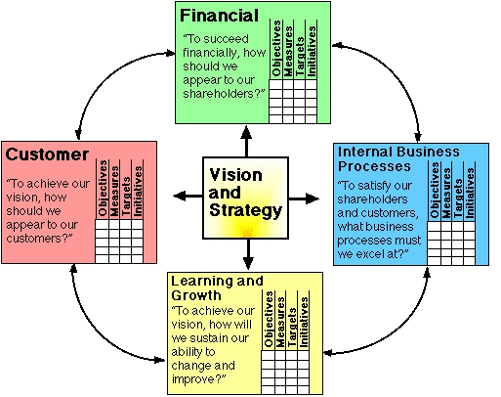
What is the balanced scorecard?

Slide 138
What is the balanced scorecard?
The balanced scorecard is centered on four performance metrics or perspectives:
  Customers
  Internal processes
  Financial
  Learning and growth
When implemented properly, each one of these perspectives contains four subparts consisting of
  Objectives
  Measures
  Targets
  Initiatives

Slide 139
Internal Process/Process efficiency
Cost
Throughput
Quality
Multiple productivity measures may include
  Labour cost as a % of sales dollars
  Sales per employee
  Machinery & equipment investments per employee
  Total labour cost per hour
  Production lead time
  Wastage percentage
  Efficiency
  WIP %
  % of defects

Slide 140
Financial Performance
The financial performance perspective of the balanced scorecard addresses the question of how shareholders view the firm and which financial goals are desired from the shareholder’s perspective.
These financial goals are dependent on the company’s stage in the business life cycle.

Slide 141
Financial Performance: Business Life Cycle
There are three main stages to this cycle which include:
  Growth stage -goal of the company is growth
    An example of a growth goal would be revenue growth.
  Sustain stage - the goal of the firm is profitability
    Measures in this stage may include ROE, ROCE, and EVA.
  Harvest stage - the goal of the firm is cash flow and reduction in capital requirements.

Slide 142
Financial Performance
The table below outlines possible financial performance objectives and their metrics.
Objective | Specific Measure
Growth | Revenue Growth
Profitability | Return on equity
Cost Leadership | Unit Cost

Slide 143
Learning & Growth

Slide 144
Key performance indicators include:
Illness rate/days of absence
Employee turnover
Gender/racial ratios
Internal promotion %

Slide 145
Sustainability indicators to measure sustainable business

